Slide 1
Understanding Arrays, Lists, ArrayLists and Dictionaries
A Comprehensive Overview

Slide 2
Topics to be Covered
Arrays
Lists
ArrayLists
Dictionaries

Slide 3
Arrays
Definition:
Arrays are a collection of items stored at contiguous memory locations. The idea is to store multiple items of the same type together.
Characteristics:
Fixed Size: The size of an array is fixed at the time of creation and cannot be changed.
Type-Safe: Arrays are strongly typed, meaning all elements must be of the same type.
Performance: Arrays provide fast access to elements because they are stored in contiguous memory locations.

Slide 4
Initialization
Int [] intArray1 = new int [5] // defining array with size 5 but no assigning values
Int[] intArray2 = new int[5]{1, 2, 3, 4, 5}; //defining array with size 5 and assigning values
int[] intArray3 = {1, 2, 3, 4, 5}; //defining array with 5 elements which indicates the size of an array

Slide 5
Lists
Definition:
Lists (specifically List<T>) are part of the System.Collections.Generic namespace and provide a more flexible way to work with collections of objects.
Characteristics:
Dynamic Size: Lists can grow and shrink in size dynamically as elements are added or removed.
Type-Safe: Lists are strongly typed, meaning all elements must be of the same type.
Performance: Lists provide fast access to elements but may have some overhead due to dynamic resizing.

Slide 6
Initialization
// You can initialize an empty list using the default constructor
List<int> numbers = new List<int>();
//You can initialize a list with a collection of elements
List<int> numbers = new List<int> { 1, 2, 3, 4, 5 };
//You can initialize an empty list and then add elements using Add() method
List<int> numbers = new List<int>();
numbers.Add(1);
numbers.Add(2);
numbers.Add(3);

Slide 7
Methods
# Initializing a list my_list = [1, 2, 3]
# Appending an item my_list.append(4) # [1, 2, 3, 4]
# Extending the list with another list my_list.extend([5, 6]) # [1, 2, 3, 4, 5, 6]
# Inserting an item at a specific index my_list.insert(1, 'a') # [1, 'a', 2, 3, 4, 5, 6]
# Removing an item my_list.remove('a') # [1, 2, 3, 4, 5, 6]
# Popping an item popped_item = my_list.pop(2) # [1, 2, 4, 5, 6], popped_item = 3
# Finding the index of an item index_of_4 = my_list.index(4) # 2
# Counting occurrences of an item count_of_4 = my_list.count(4) # 1
# Sorting the list my_list.sort() # [1, 2, 4, 5, 6]
# Reversing the list my_list.reverse() # [6, 5, 4, 2, 1]

Slide 8
Array Lists
Definition:
Array Lists are used to create a dynamic array, there is no need to specify the size of the ArrayList. ArrayList represents an ordered collection of an object that can be indexed individually. In ArrayList, you can store elements of the same type and of the different types.
Characteristics:
Dynamic Size: ArrayLists can grow and shrink dynamically as elements are added or removed, providing flexibility.
Type-Safe: ArrayList is not type-safe, meaning it can hold elements of different types.
Performance: ArrayLists offer fast access to elements but may have overhead due to dynamic resizing. Access time is typically O(1), while insertion and deletion times can vary.

Slide 9
Initialization
// Create an instance of Array List
ArrayList arrayList = new ArrayList();
//You can add elements to the Array List using Add() method
arrayList.Add(1);
arrayList.Add("Hello");
arrayList.Add(3.14);
//You can also initialize an ArrayList with a collection of elements:
ArrayList arrayList = new ArrayList() { 1, "Hello", 3.14 };

Slide 10
Dictionaries
Definition:
Dictionaries are a type of data structure that store elements in key-value pairs. They are highly efficient for lookups, insertions, and deletions based on keys.
Characteristics:
Key-Value Pairs: Stores elements as unique key-value pairs.
Unique Keys: Keys must be unique; duplicate keys overwrite previous values.
Efficient Lookups: Fast lookups, insertions, and deletions, typically O(1) on average.

Slide 11
Initialization
// Adding key-value pairs
Dictionary<int, string> dict = new Dictionary<int, string>();
dict.Add(1, "One");
dict.Add(2, "Two");
dict.Add(3, "Three");
// Initialization with elements Dictionary
<int, string> dictWithElements = new Dictionary<int, string>() {
{ 1, "One" },
{ 2, "Two" },
{ 3, "Three" }};

Slide 12
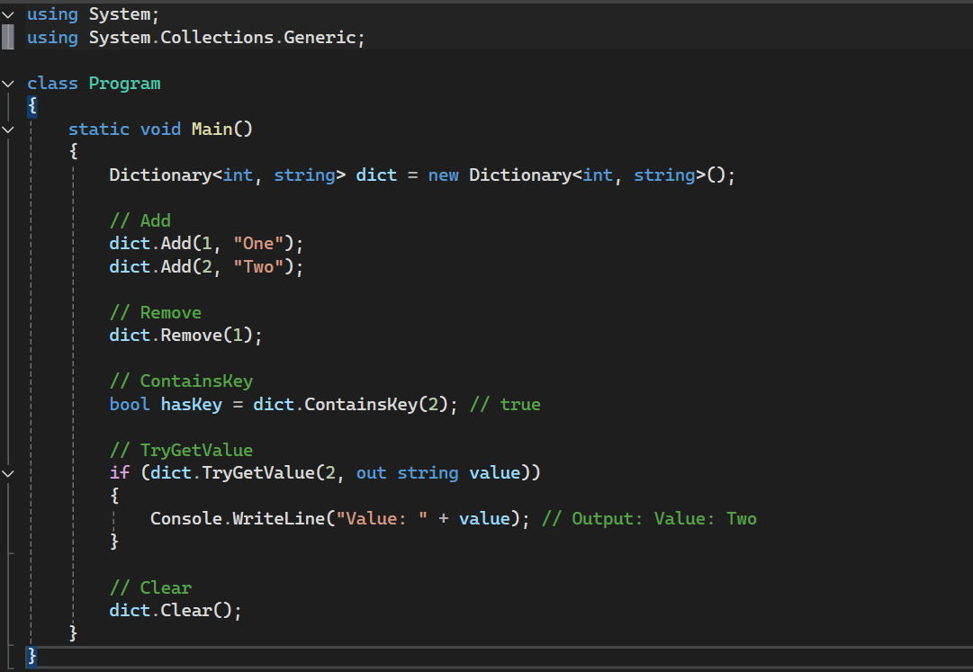
Common Methods
Add: Adds a key-value pair to the dictionary.
Remove: Removes the value with the specified key.
ContainsKey: Checks if the dictionary contains a specific key.
TryGetValue: Gets the value associated with the specified key.
Clear: Removes all key-value pairs from the dictionary.

Slide 13
THANK YOU

